Slide 1
This Power Point will guide you through successfully submitting a Central Registry Check for Campbellsville University School of Nursing Pre-Admissions requirements.
Things to have ready before beginning registry:
Make sure you are using Internet Explorer (not Edge,) Chrome or Mozilla. Mobile phone support is currently not available.
Central Registry Checks can take up to 30 days for completion. Please ensure you are submitting in appropriate time frame to allow completion for Pre-Admissions requirements.
Please have at least one form of supporting identification documentation saved to your computer for uploading to application when prompted, (Driver’s License/State ID, Birth Certificate, SSN Card, Passport, Work ID.)
Please have credit/debit card information. A non-refundable payment will be required for completion.

Slide 2
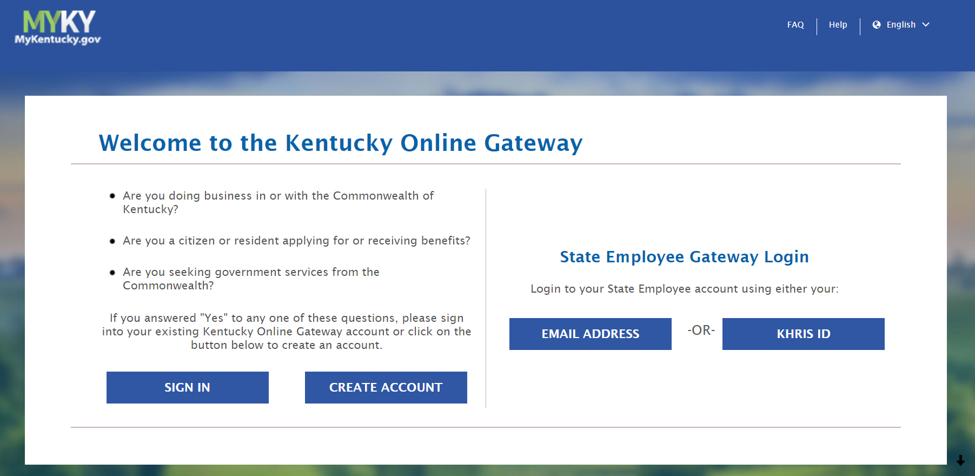
Open your browser and enter the following URL https://ssointernal.chfs.ky.gov
Sign in if you already have an Kentucky Online Gateway account, if not select create account.
Please select
Create Account

Slide 3
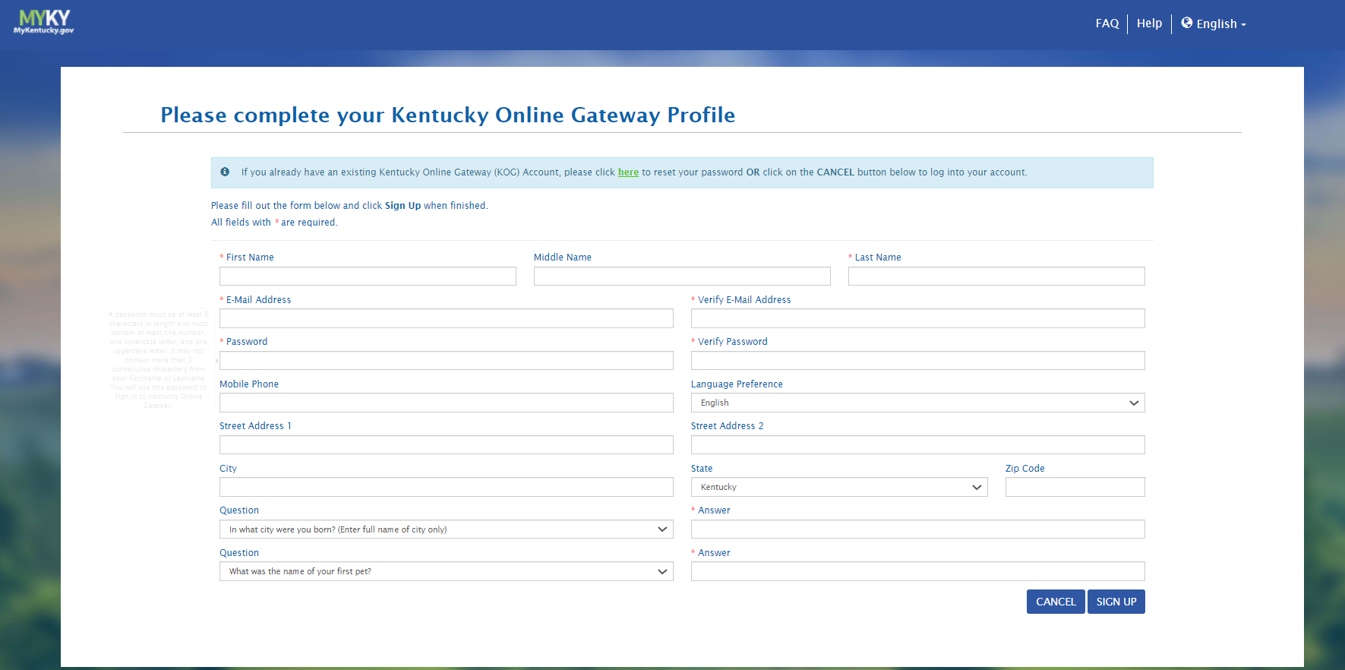
3. Complete the required form below and click Sign Up when finished.

Slide 4
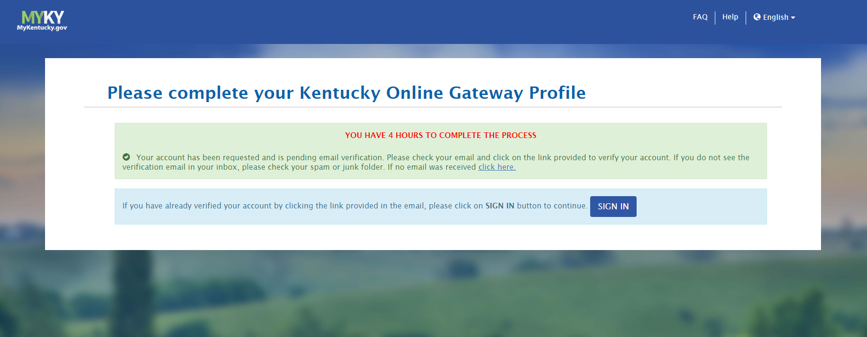
4. You will automatically receive an email from KOG_DoNotReply to the email used to set your KOG profile. Please check for this email and follow the directions in the email to finish verification for account set up.

Slide 5
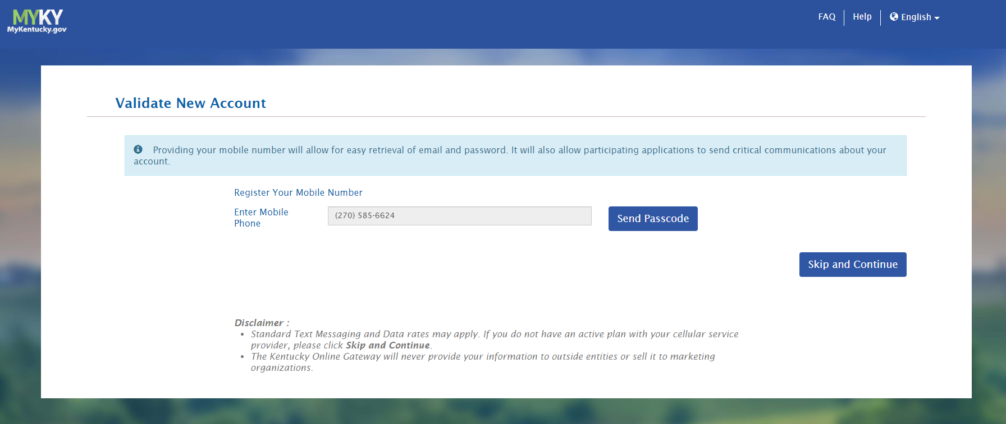
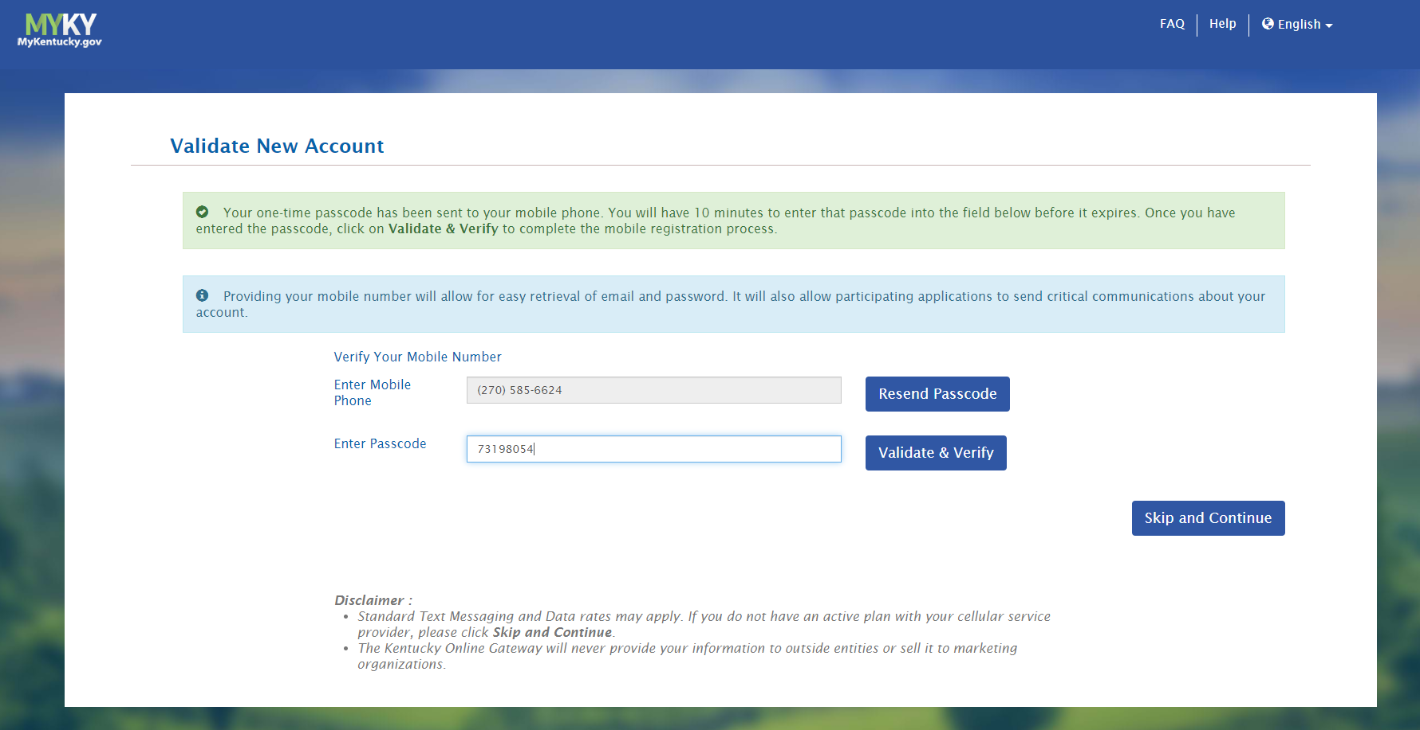
5. Once you click the account verification link in your email, you will be prompted to Validate New Account.
Select Send Passcode
Enter passcode and Select Validate & Verify

Slide 6
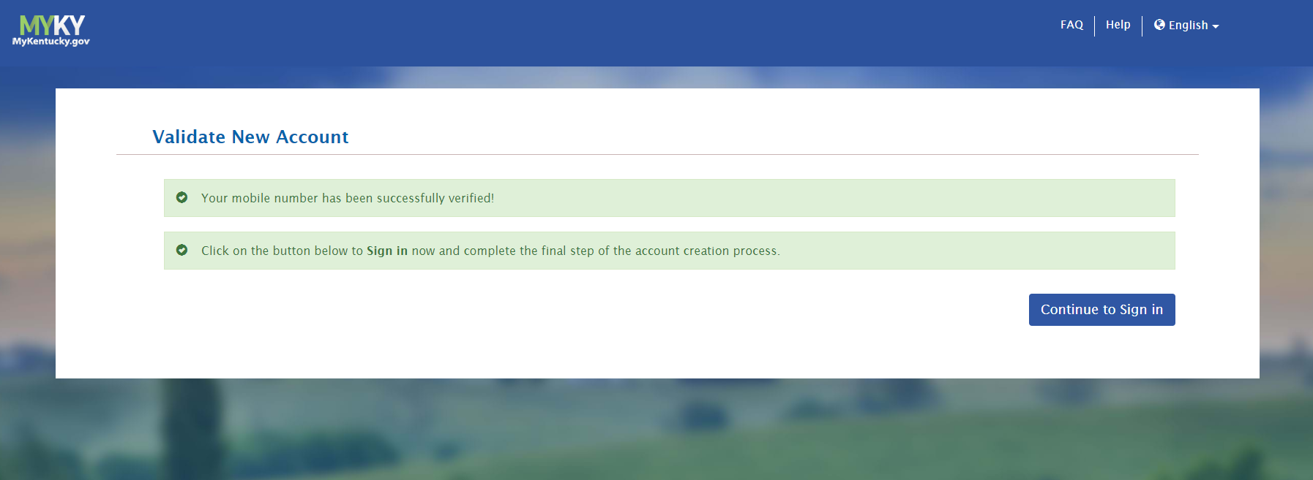
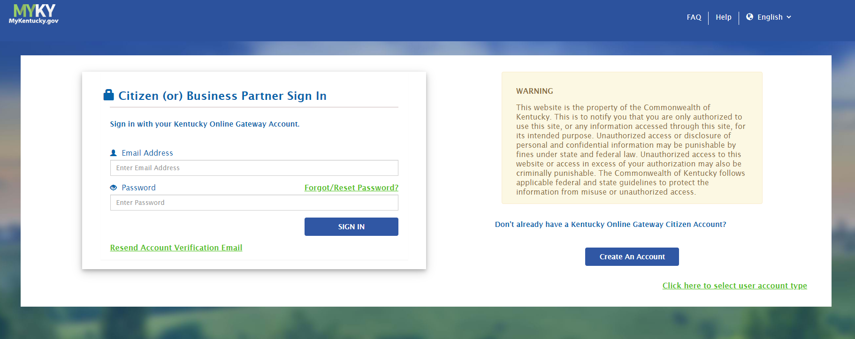
6. Continue to Sign In
7. Sign in using email and password for new KOG account.

Slide 7
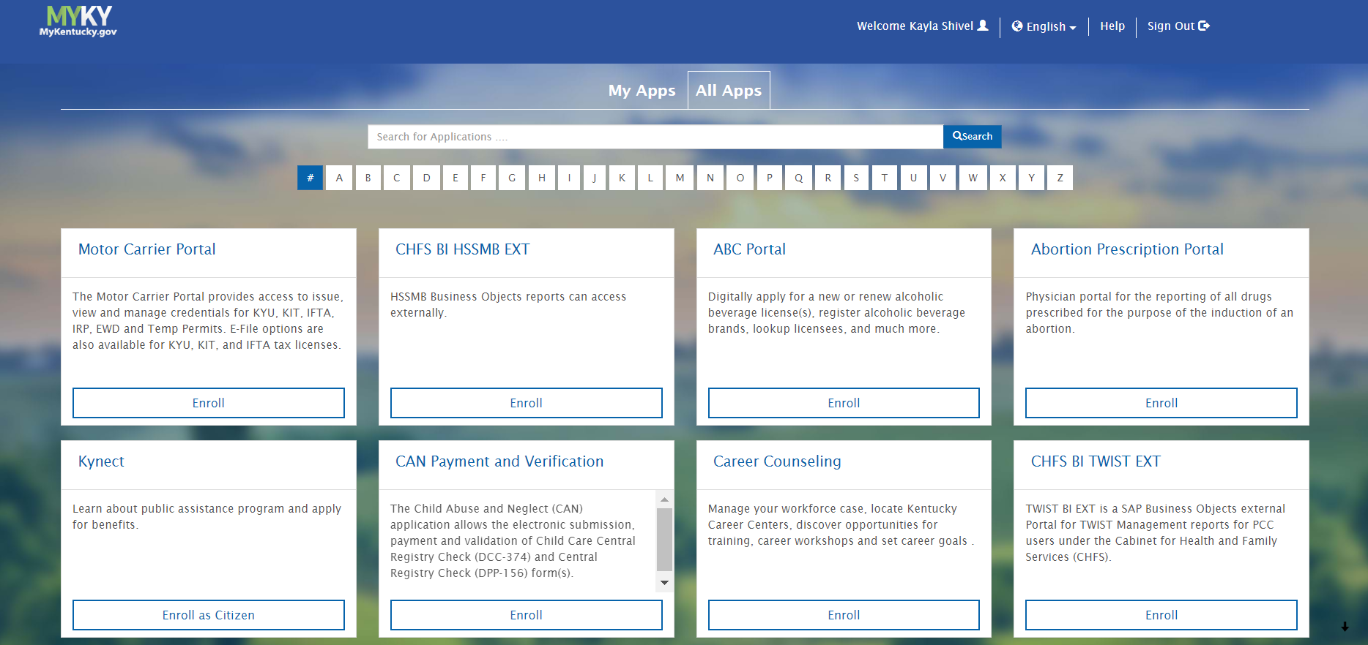
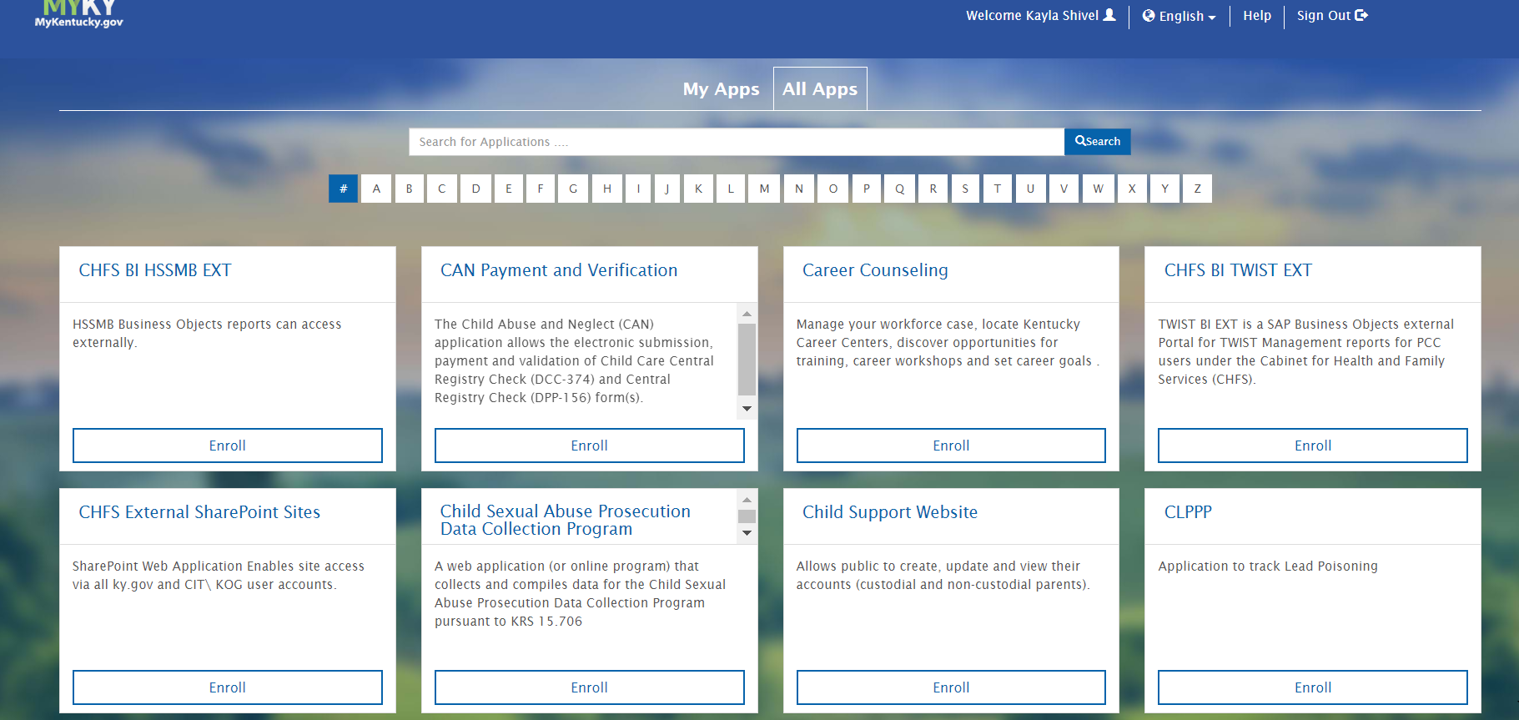
8. Select the letter “C” from the alphabet list to narrow the search.
9. Select CAN Payment and Verification (Child Abuse and Neglect) from the application list.

Slide 8
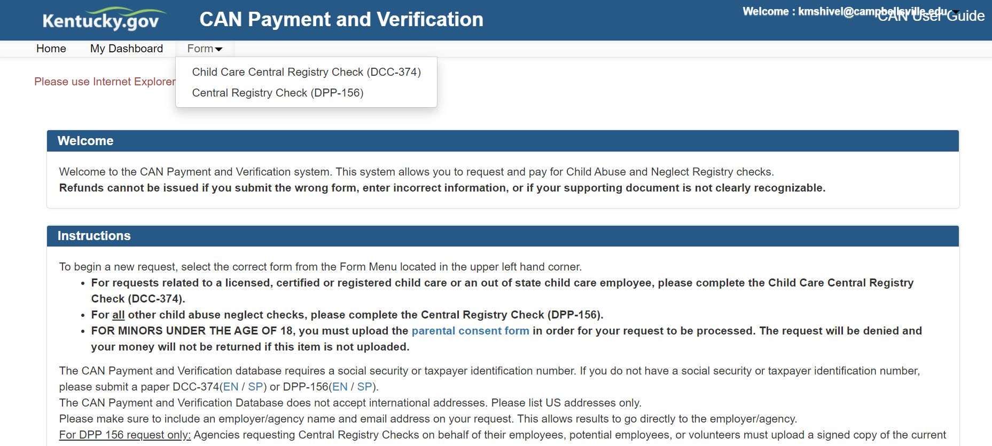
The CAN Payment and Verification Home Screen will be displayed. Please note that this application currently only supports the following browsers: Internet Explorer (not Edge,) Chrome or Mozilla. Mobile phone support currently is not available.
10. To submit a CAN request, select the desired request type from the Form dropdown. Select Central Registry Check (DPP-156) for central registry checks.

Slide 9
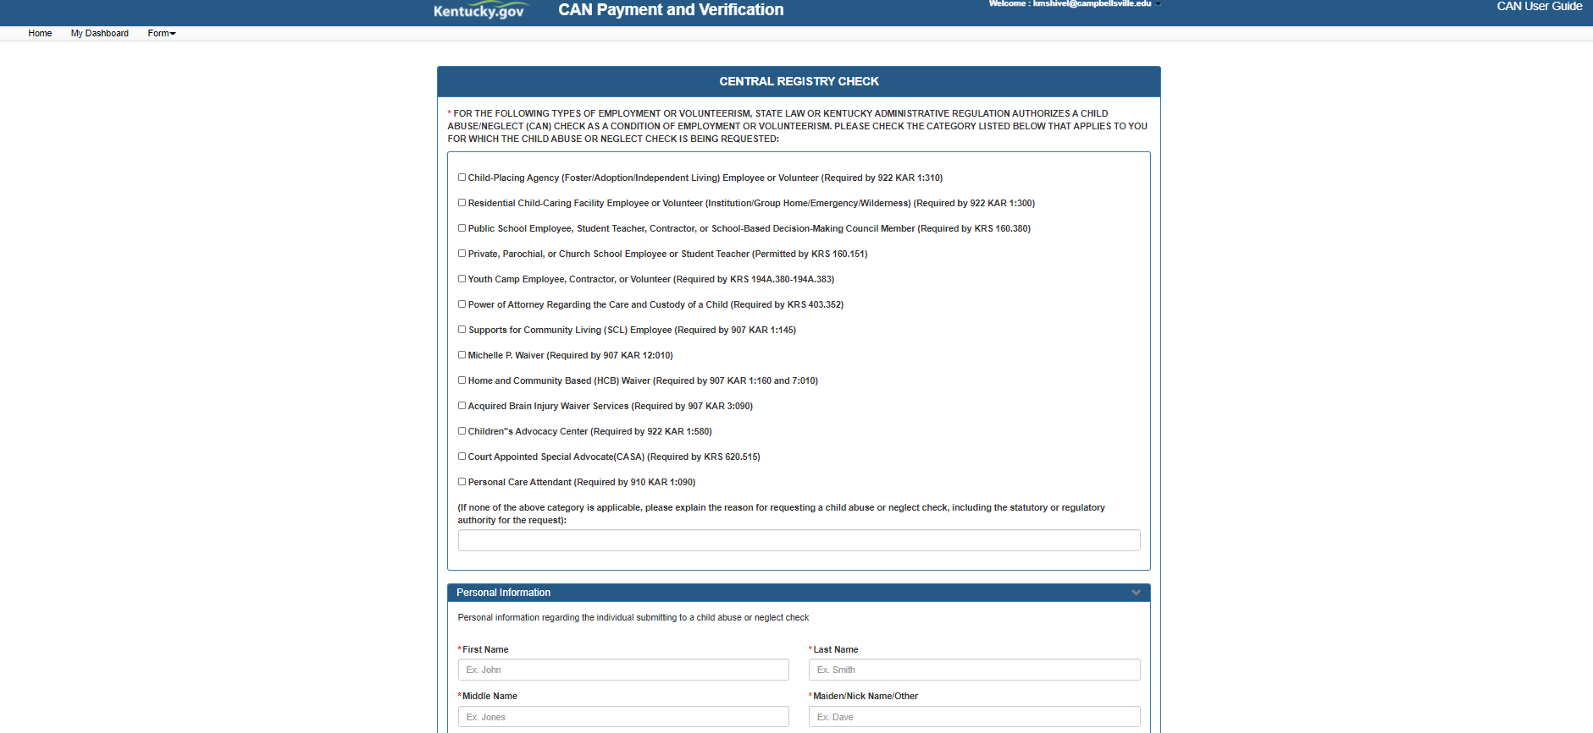
11. Select Supports for Community Living (SCL) Employee (Required by 907 KAR 1:145) AND Michelle P. Waiver (Required by 907 KAR 12:010)
12. Once selected, continue to scroll down and enter all the required Personal Information fields.

Slide 10
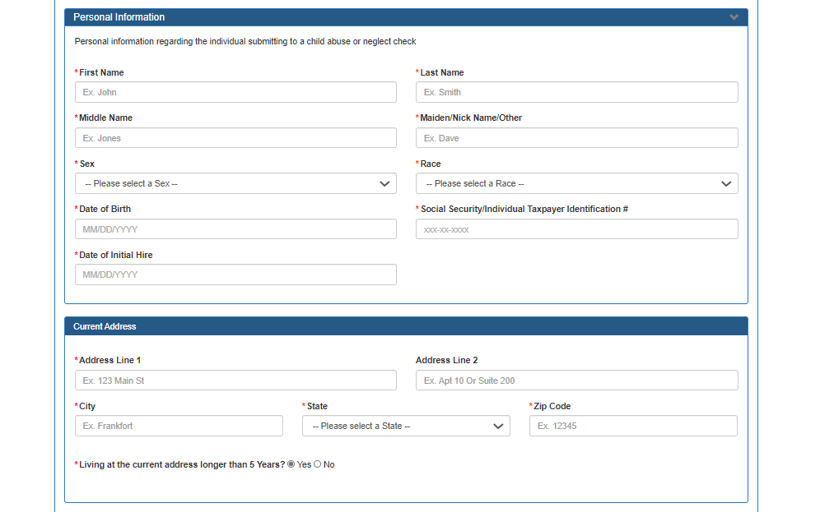
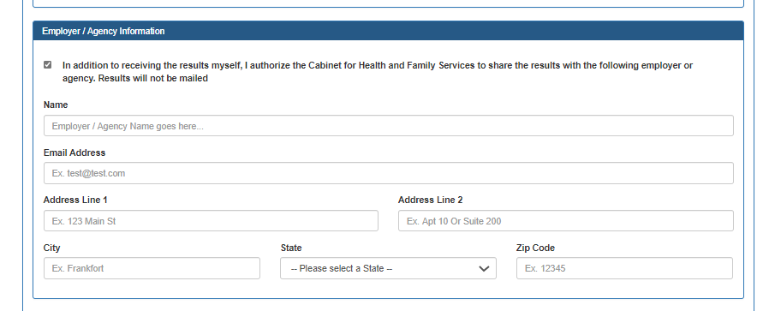
13. All Personal Information fields are required.
If either Middle Name or Maiden/Nick Name/Other is not applicable enter N/A.
14. All Current Address fields are required except Address Line 2.
15. Please select option under Employer/Agency Information.
Campbellsville University School of Nursing
rgvale@Campbellsville.edu
Please enter the exact information provided in these fields to ensure your request is correctly sent to the School of Nursing.
Results will not be mailed. Please ensure you have entered the correct emailed provided.
1 University Drive UPO 800
Campbellsville
KY
42718

Slide 11
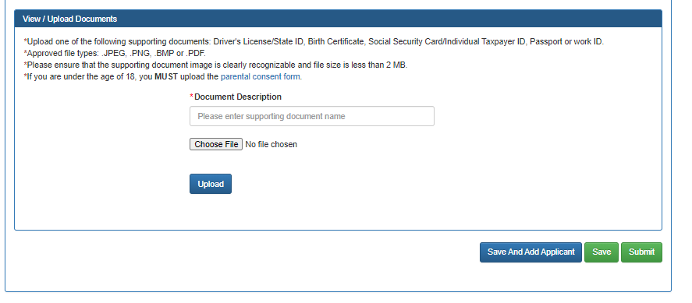
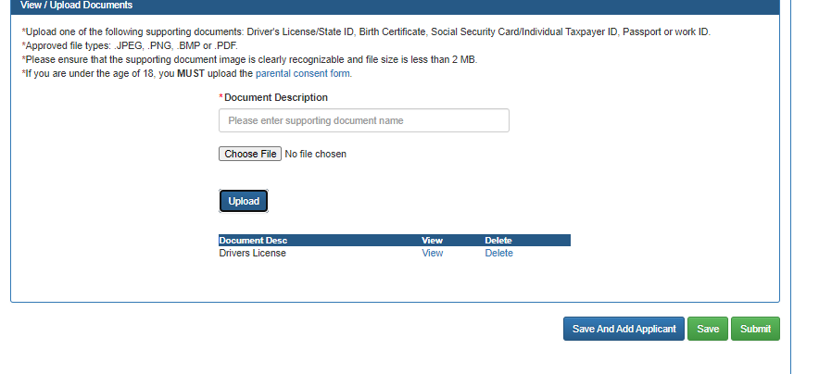
16. Upload Drivers License/State ID, Birth Certificate, SS Card, Passport or Work ID, by
Entering the appropriate document name in empty field
Selecting Choose File
Select File from your documents
Select Upload
If you are under the age of 18, you must upload a completed copy of the parental consent form (link located in this section.)
The document fil type should be: JPEG, PNG, BMP, PDF.
Please ensure that the document image is clearly recognizable.
Ensure that the document was uploaded.
Select Submit.

Slide 12
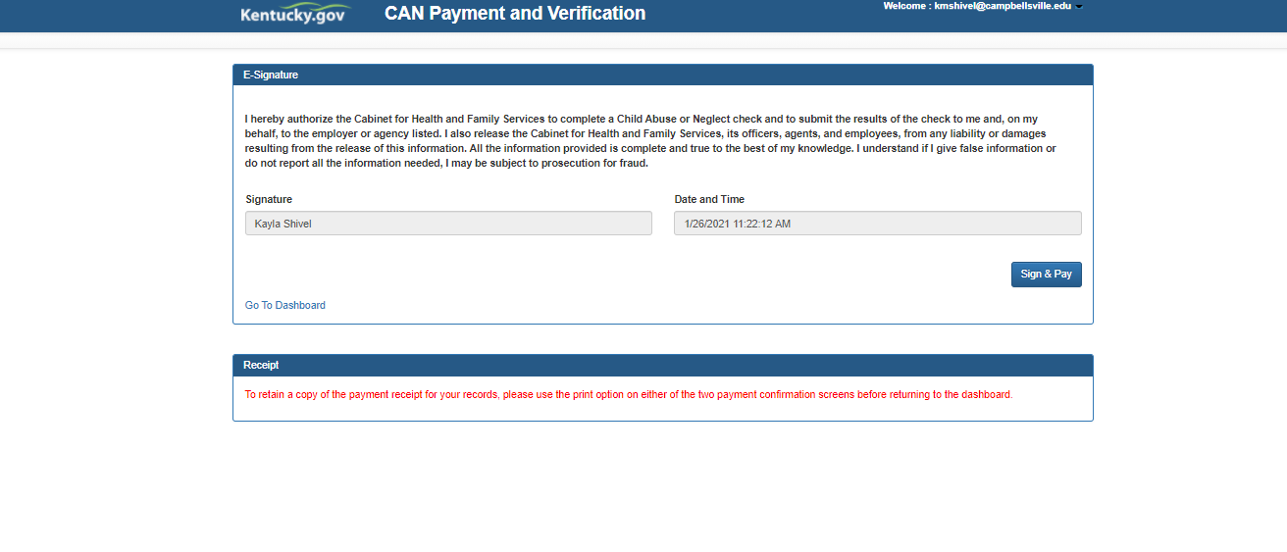
17. A confirmation screen will prompt you to either cancel or submit. Select Submit.
18. Two options will appear for payment: Agency Payment Code and Pay by Credit/Debit Card.
Select Pay by Credit/Debit Card, and press Proceed to E-Sign.
19. Select Sign & Pay

Slide 13
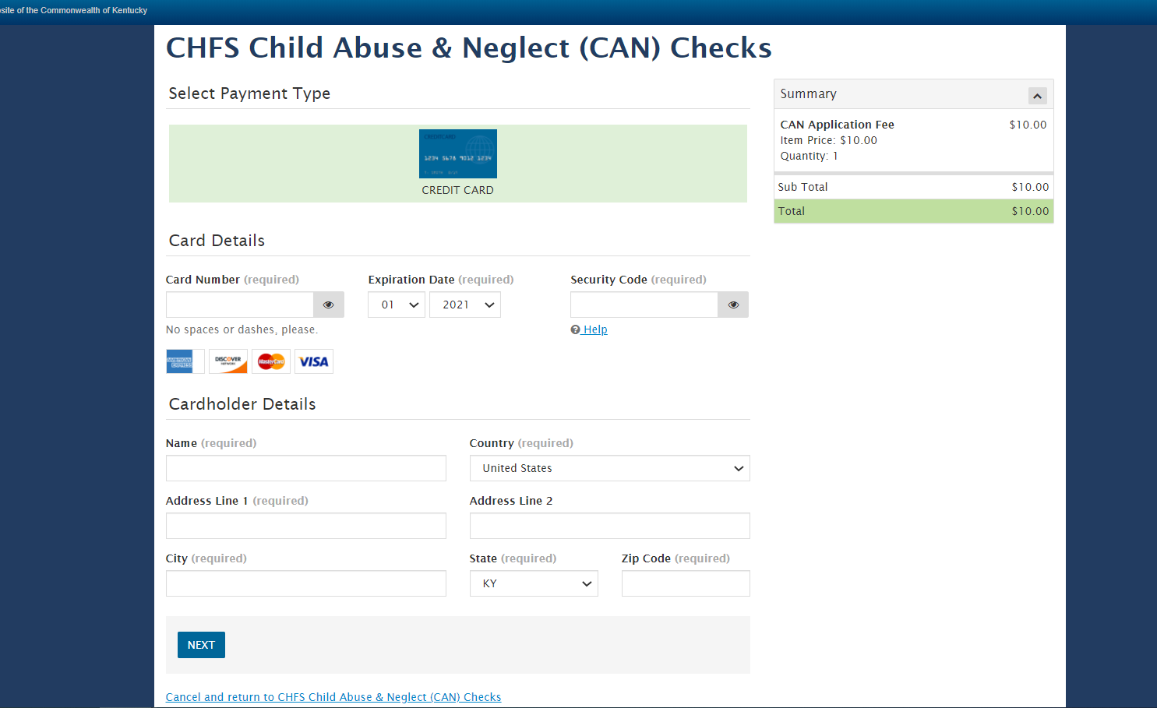
20. Enter your credit card/debit card information on the Select Payment Type page.
There is a non-refundable Fee for each CAN Check.
All Fields are required expect Address Line 2 and email emails.
Select next to continue to payment overview

Slide 14
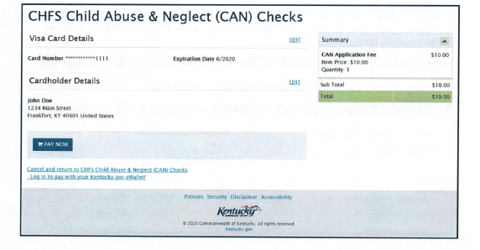
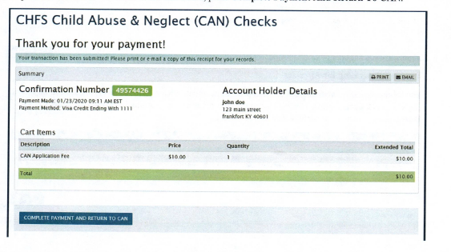
21. Select Pay Now
22. Select Complete Payment and Return to CAN

Slide 15
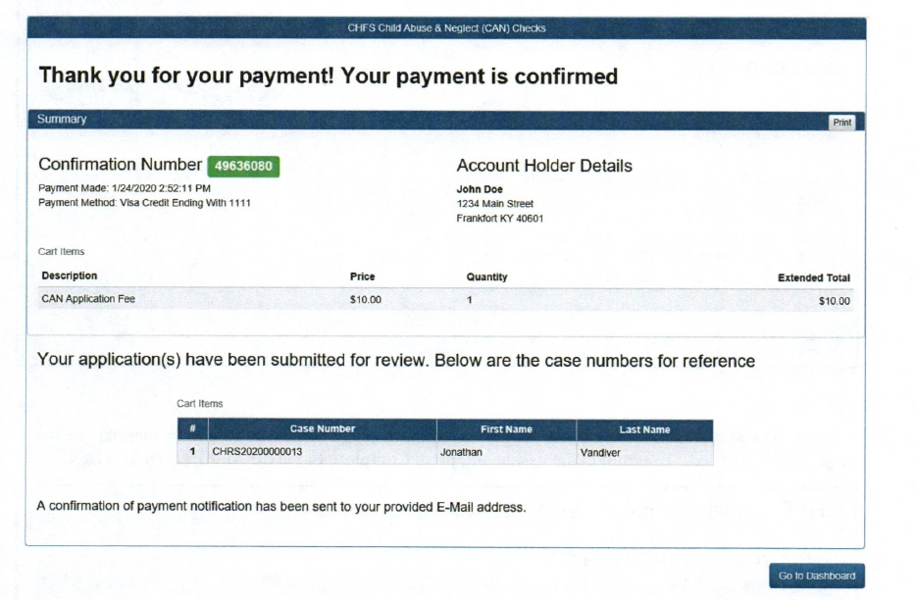
A confirmation screen will appear and an email will be sent to the address on file.
To return to the dashboard, press Go To Dashboard.
The status of your request will update to Submit.
Please allow up to 30 days for processing.
When your results have been completed, you will receive a confirmation email at the address on file.
Once you have received completed confirmation email, you can return to the dashboard to view or print the results.

